Slide 1


INSTITUTE FOR ADVANCED COMPUTING AND SOFTWARE DEVELOPMENT AKURDI, PUNE
Documentation On
“ETHICAL HOME LOAN”
PG-DAC SEPT 2022
Submitted By:
Group No: 13
Name:
Abhiram Belorkar Shreyansh Ranka
Roll No. 229017
229091
Mrs. Sonali Mogal
Project Guide
Mr. Rohit Puranik
Centre Coordinator
1

Slide 2
POINTS TO BE DISCUSSED
Introduction
Objectives
UML Diagrams
UI Diagram
Specification
S/W and H/W
Requirements
Advantages
Disadvantages
Conclusion
Future Scope
References

Slide 3
INTRODUCTION
A home loan is a secured loan that is obtained to purchase a property by offering it as collateral. Home loans offer high-value funding at economical interest rates and for long tenors.
They are repaid through EMIs. After repayment, the property's title is transferred back to the borrower.
The project objective is to create a web-based application for banks and financial institutions to manage home loan applications from their administrative backend.
The backend will be responsible for managing the loan application process, which includes validating user inputs, processing applications, and storing data in a database.

Slide 4
OBJECTIVE
The main objective of this project is to buy a Home through finance Loan Company and to implement all the loan process by developing a code.
First here, if we want to buy a Home then we will go to Builder, and he will explain the whole process to us and gives a quotation.
If we do not have that much money in current situation, then he will suggest us to take a loan. As already some banks have tied up with them e.g., ICICI, HDFC, SBI, and some other finance companies.
Then they will suggest us those providers and there’s one relation executive person will contact you and explain all the process of Loan. Every bank has different process.

Slide 5
TECHNOLOGY USED
Front End: React JS
Back End: Spring Boot
Database: MySQL

Slide 6
UML Diagrams
(Unified Modeling Language

Slide 7
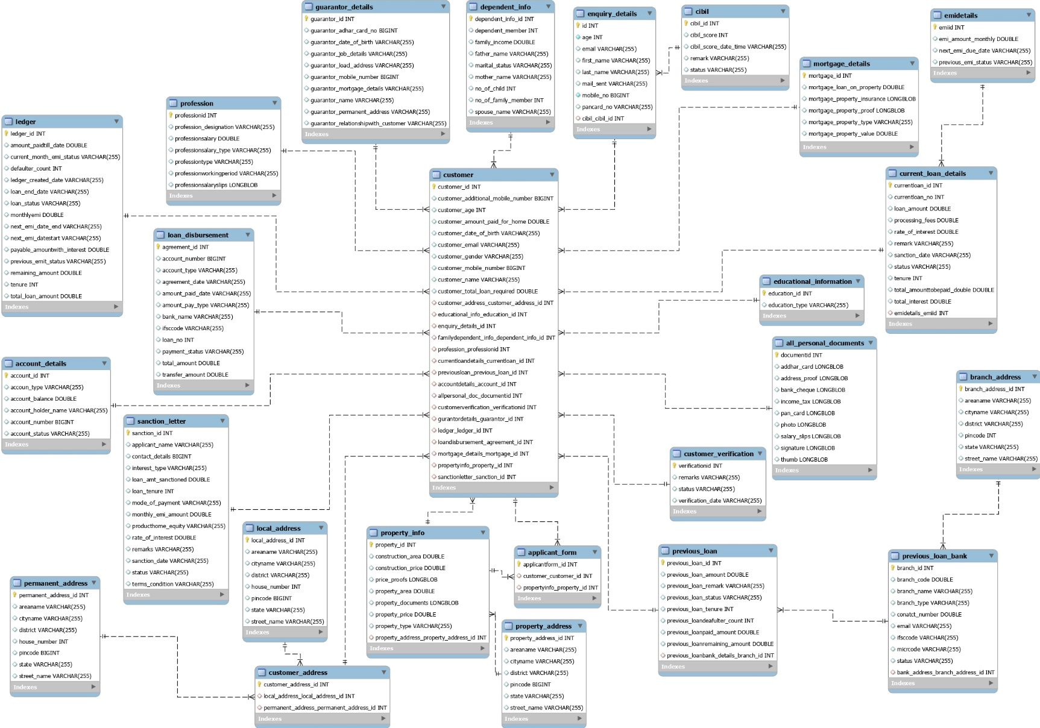
ER Diagram

Slide 8
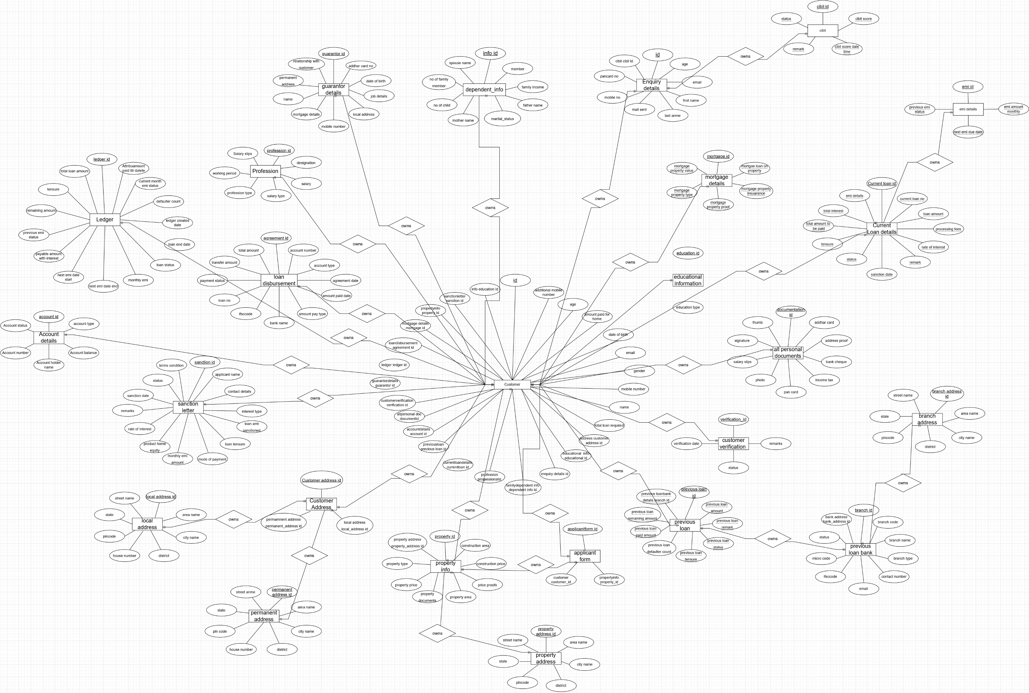
ER Diagram(Manual)

Slide 9
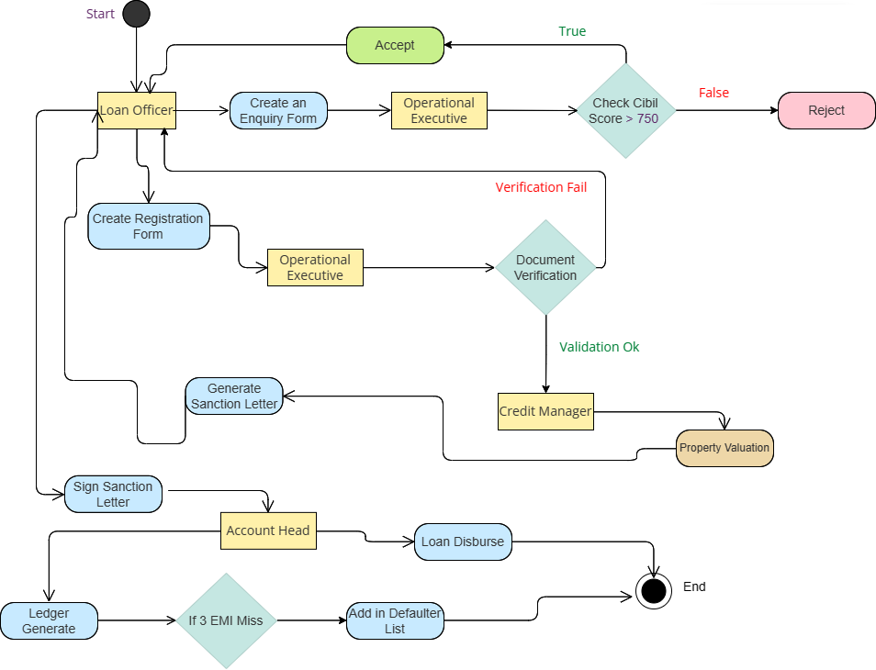
Activity Diagram

Slide 10
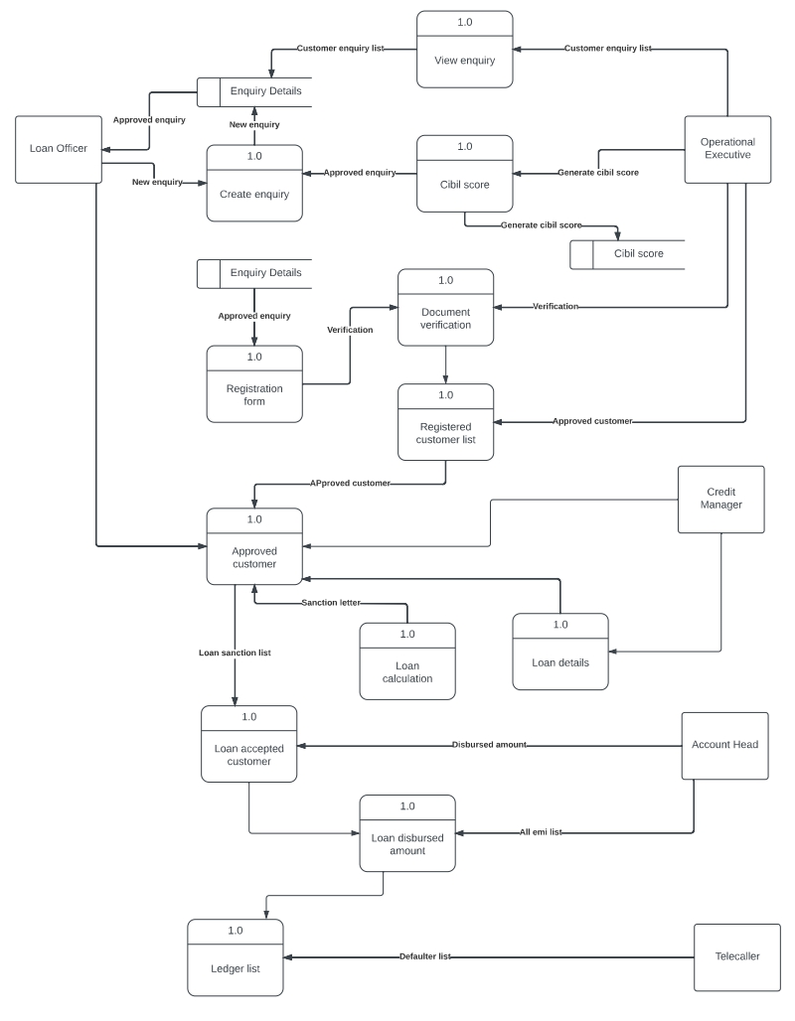
DFD Diagram

Slide 11
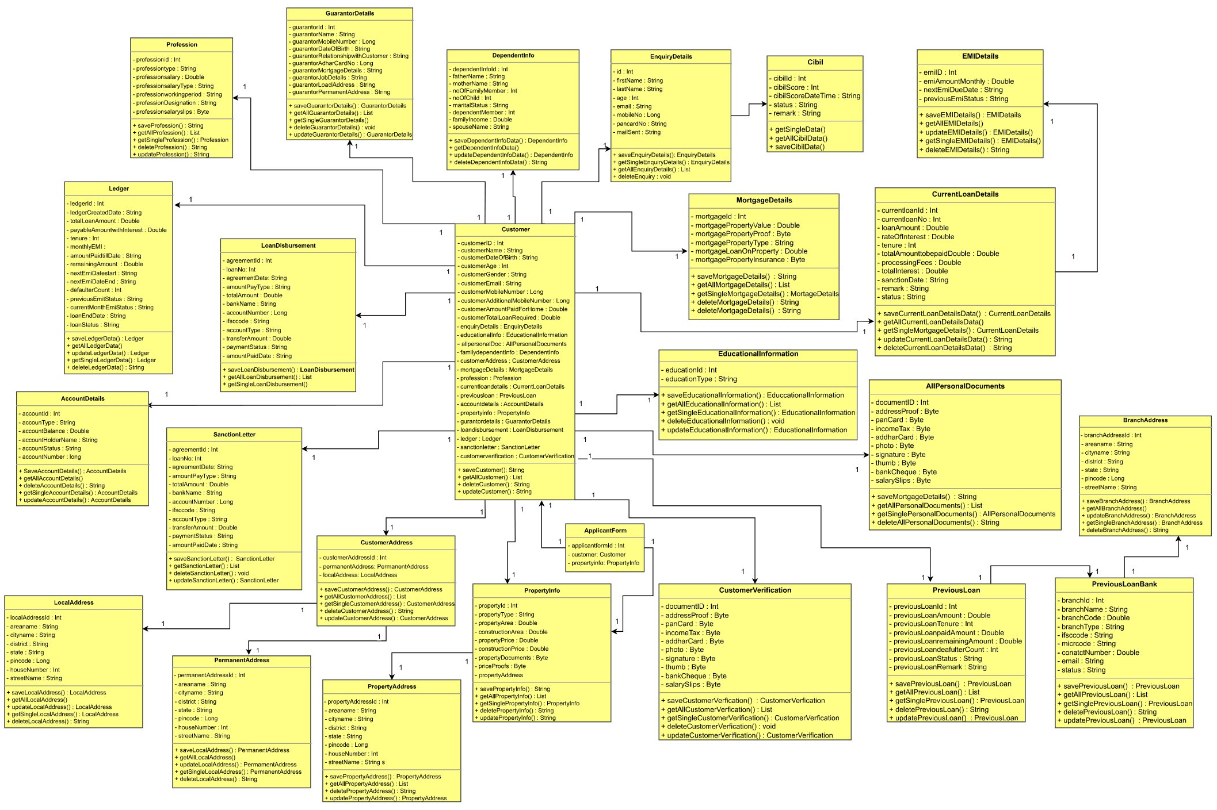
Class Diagram

Slide 12
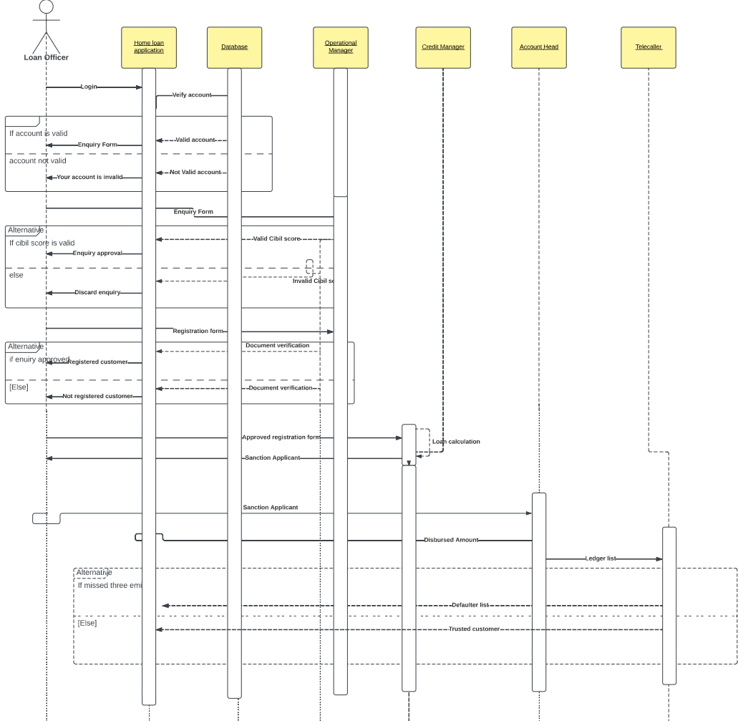
Sequence Diagram

Slide 13
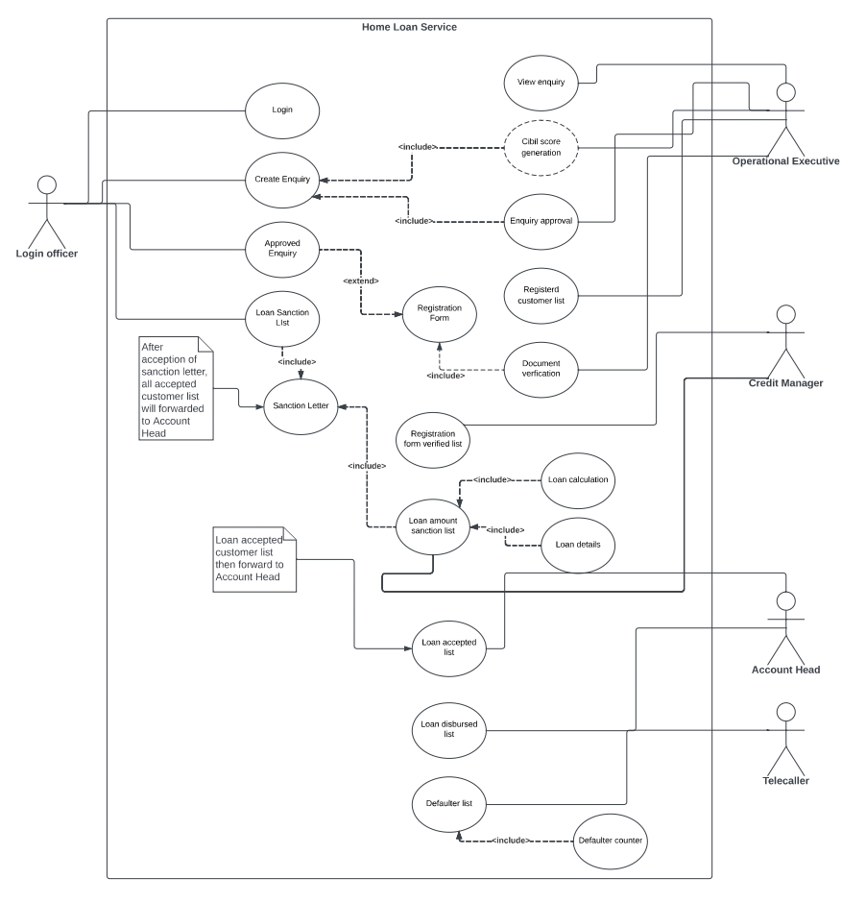
Use Case Diagram

Slide 14
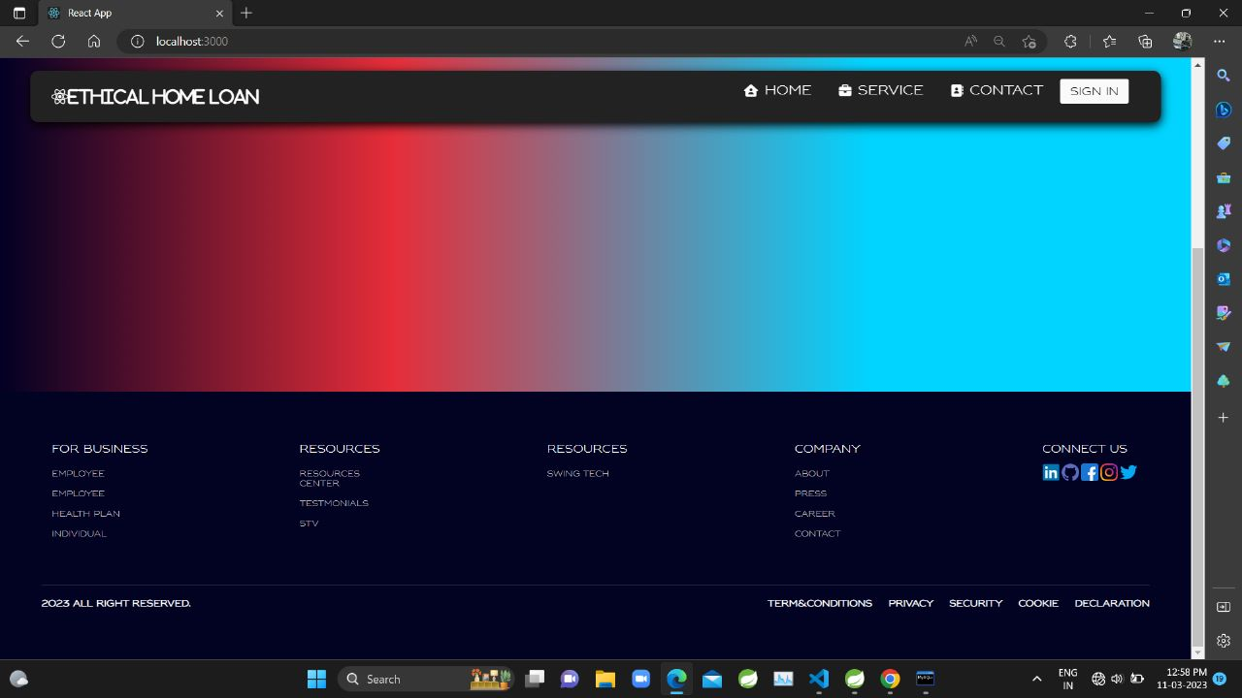
UI DIAGRAMS
Home Page

Slide 15
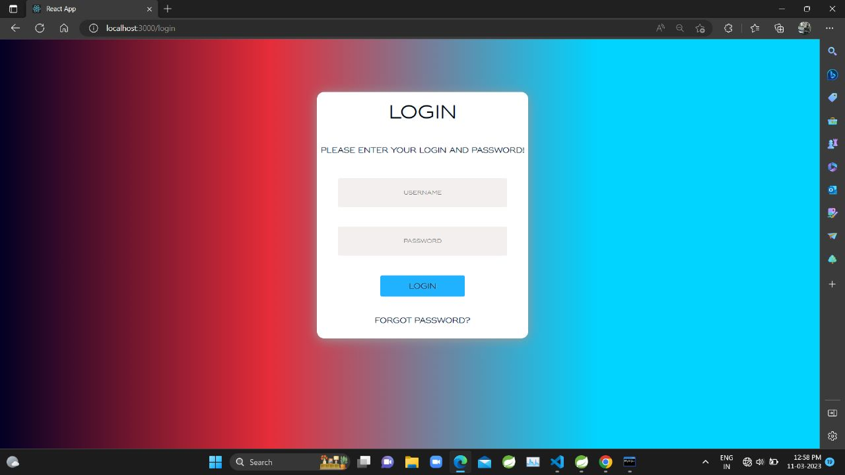
Login Page

Slide 16
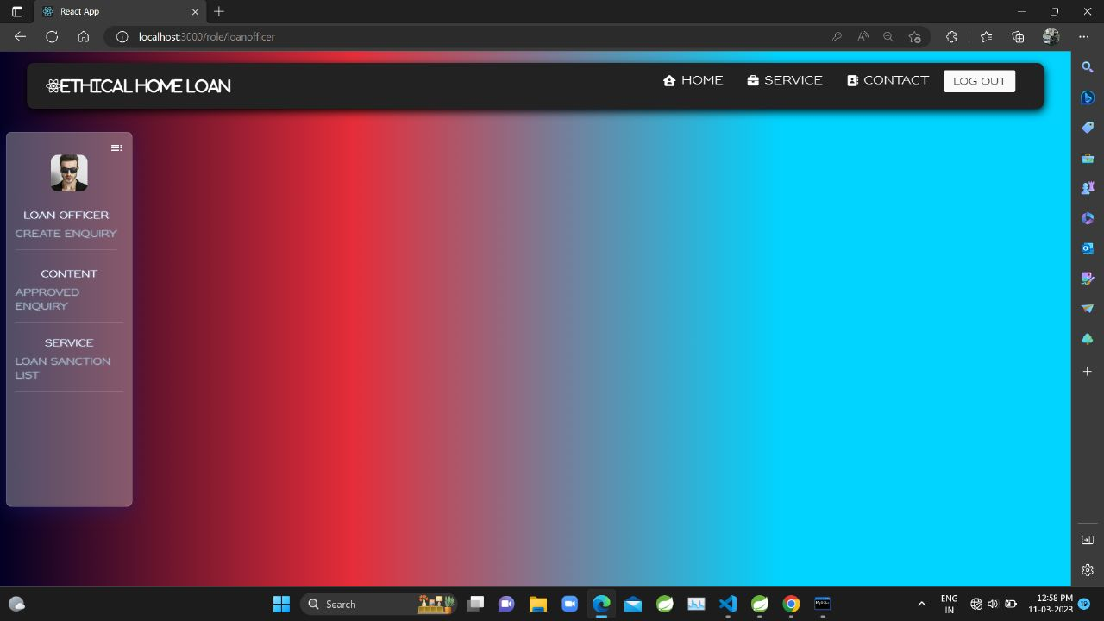
Loan Officer Page:

Slide 17
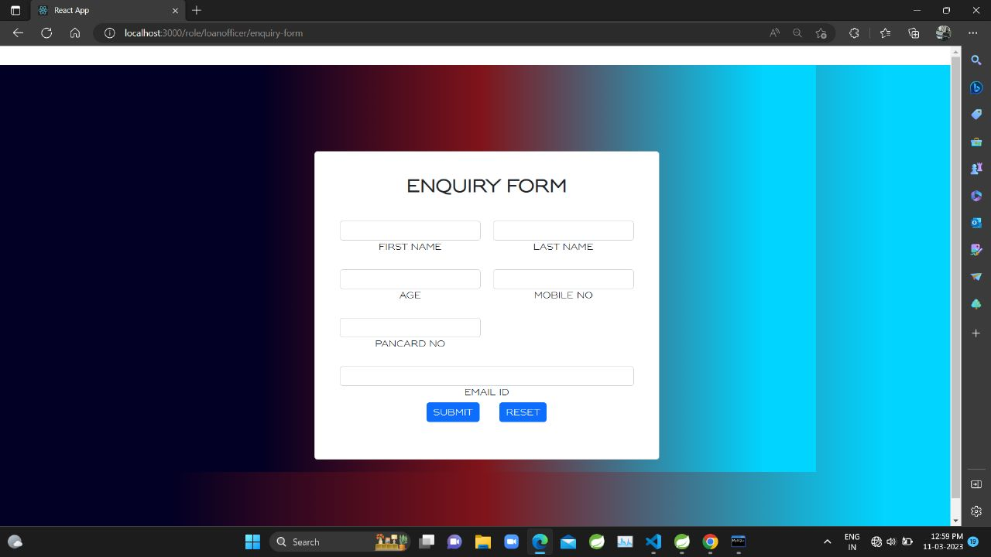
Enquiry Page

Slide 18
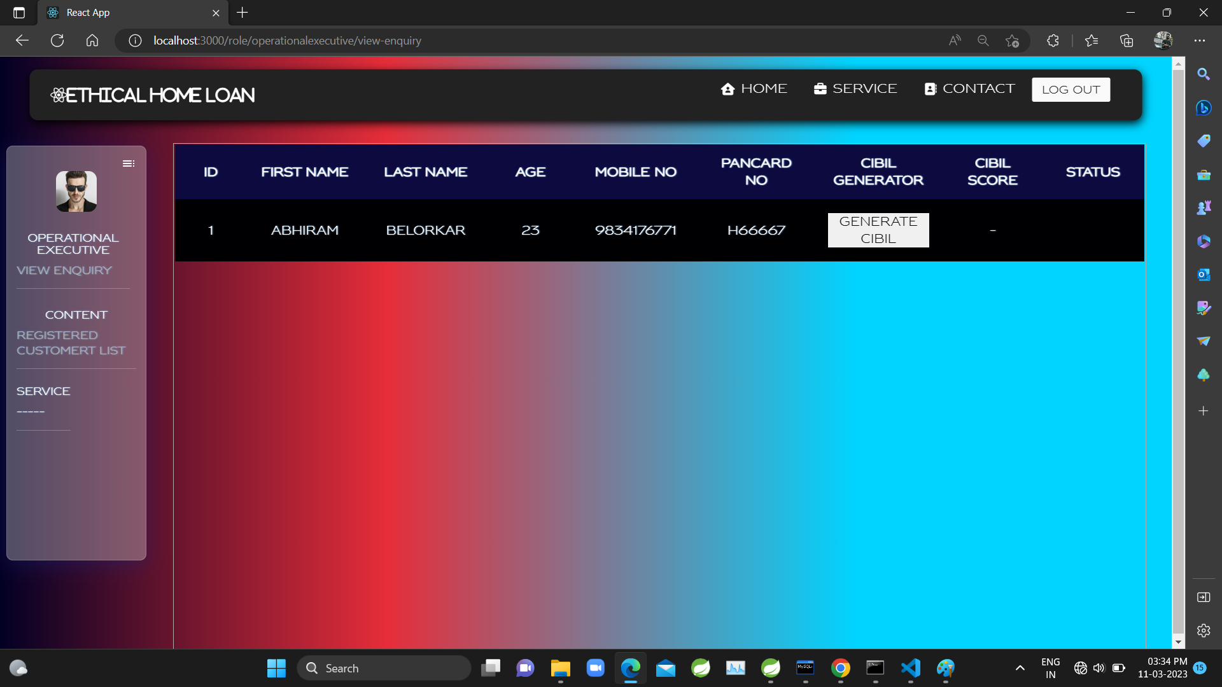
Operational Executive CIBIL generation page

Slide 19
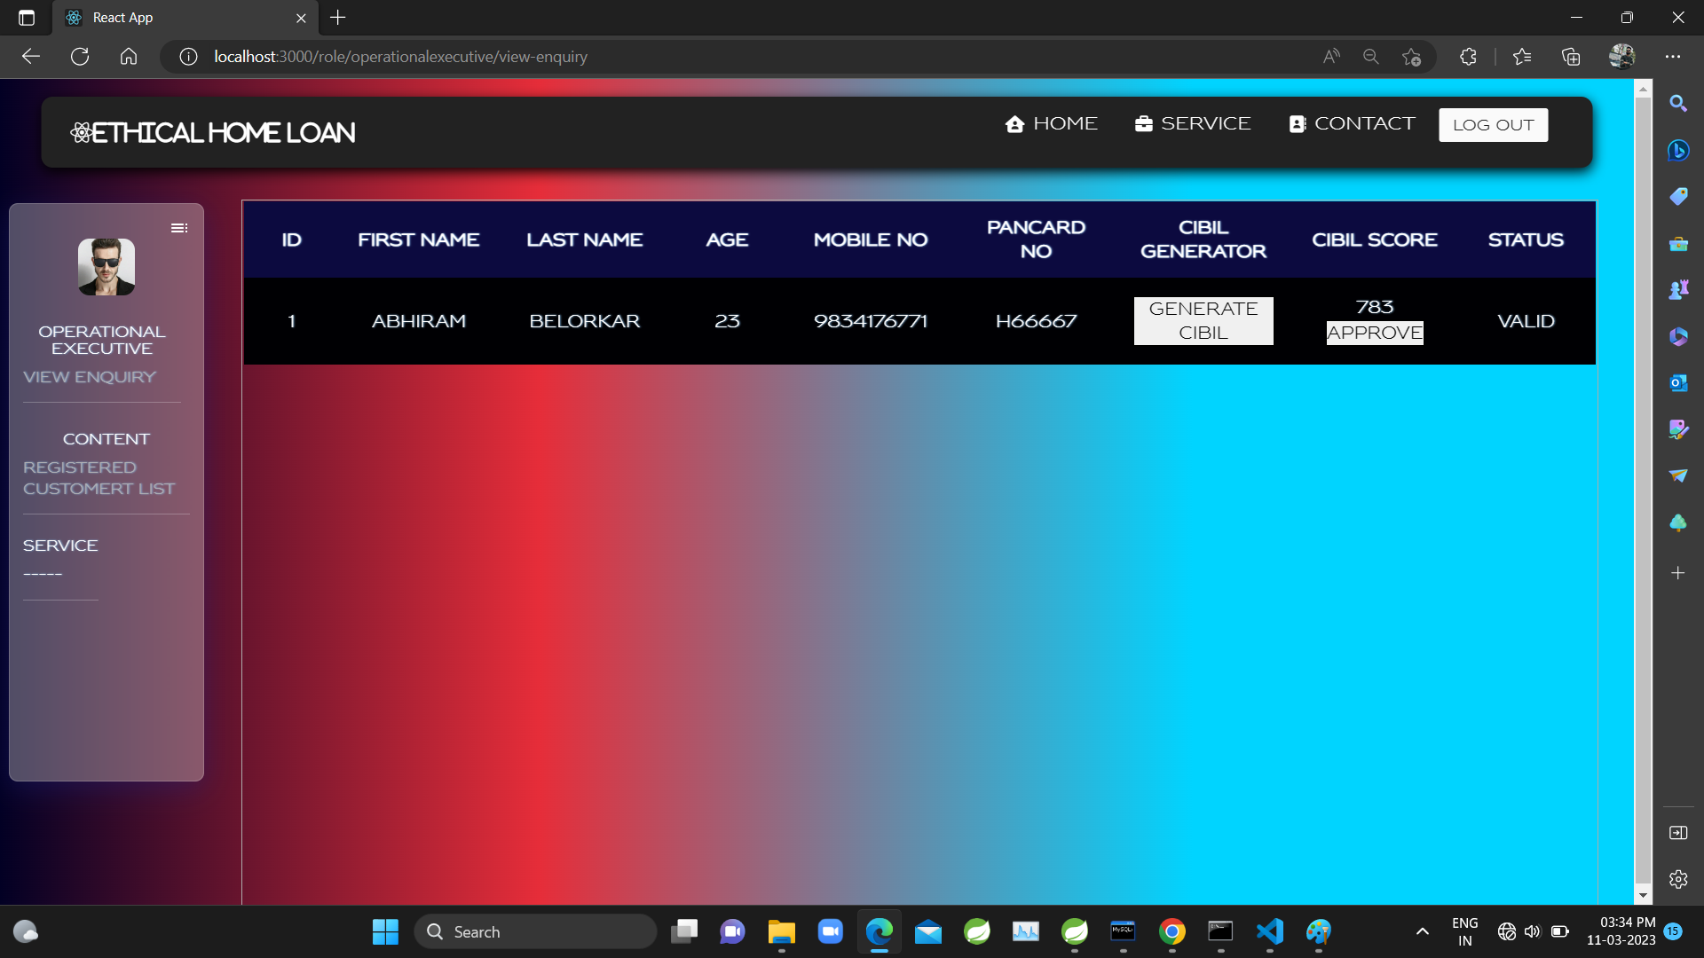
Operational Executive CIBIL generated page

Slide 20
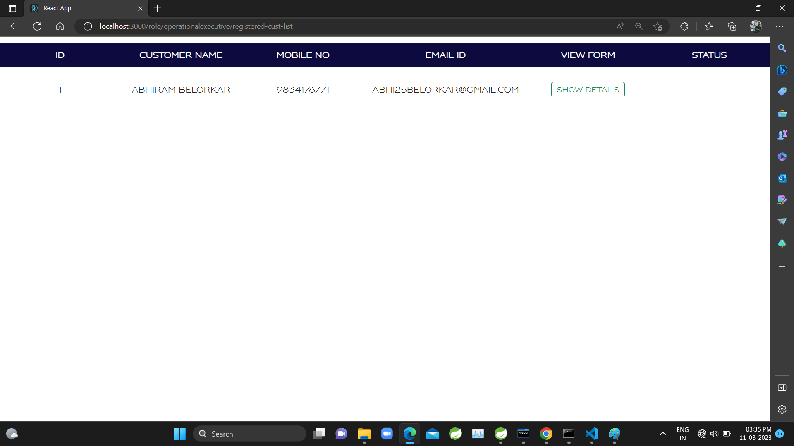
Registration Customer List Page

Slide 21
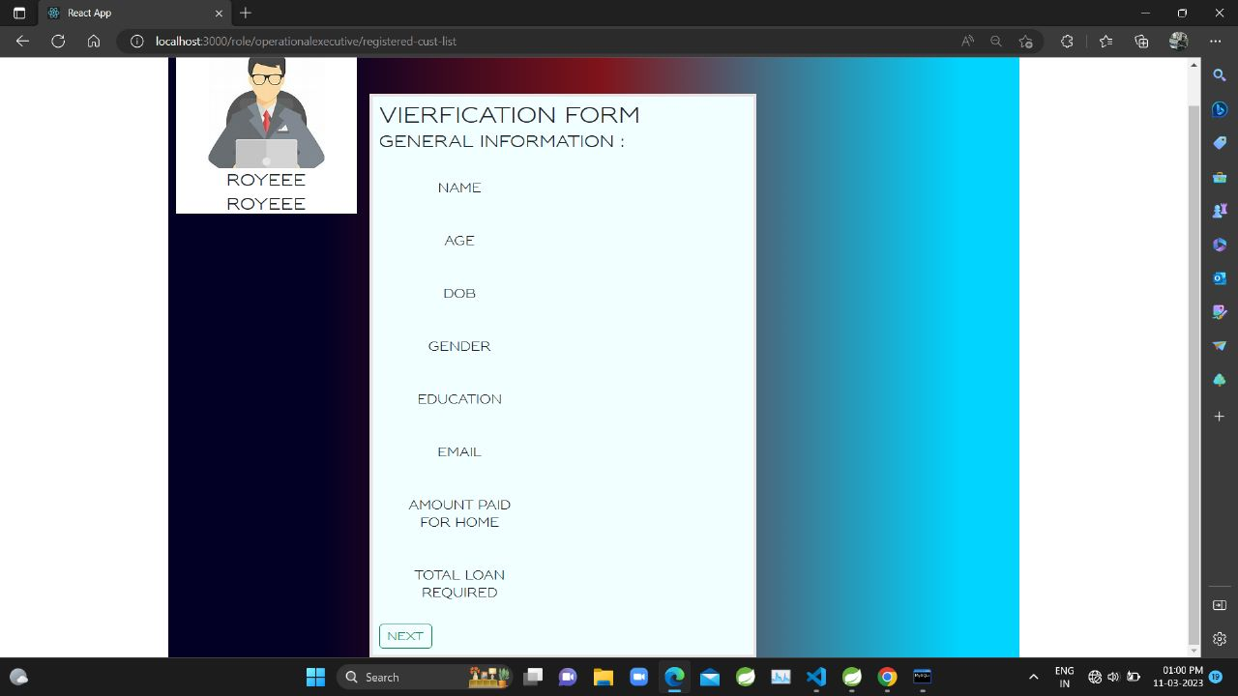
Verification page

Slide 22
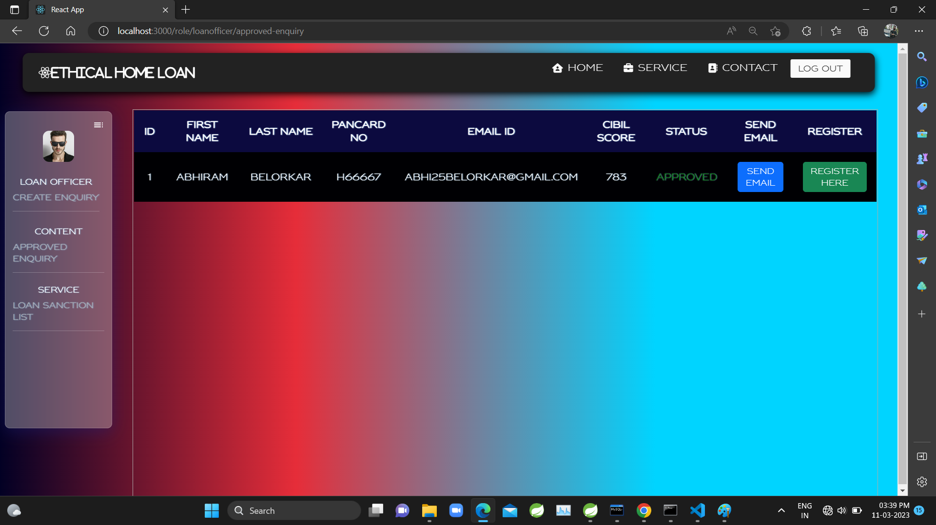
Approved Enquiry

Slide 23
SPECIFICATION
The application will use Spring-Boot and React as main web technologies.
HTTP is used for communication between clients and servers over the internet
Several types of validations make this web application a secured one and SQL Injections can also be prevented.
Since Ethical Home Loan is a web-based application, internet connection must be established.
The Ethical Home Loan will be used on PCs and will function via internet or internet in any web browser.

Slide 24
S/W and H/W REQUIREMENTS
Server Side:
Processor: Intel Dual Core
HDD: Minimum 250GB Disk Space
RAM: Minimum 4GB
OS: Windows 8 and above
Database: MySQL
Client Side (minimum requirement):
Processor: Intel Dual Core
HDD: Minimum 250GB Disk Space
RAM: Minimum 4GB
OS: Windows 8 and above

Slide 25
ADVANTAGES
Easy to access the customer data.
Easy CIBIL score generation
Can review customer applications.
Can know about which type of people are applying for home loan, which will became easy for marketing team to target the customers.
DISADVANTAGES
It requires active internet connection.

Slide 26
CONCLUSION
The web site provides synchronization between the employees of the bank.
Here, the individual employee can find the data of all of all customers applying for loan, so that they can call them back for taking updates.
It saves a lot of time for processing the request of the application.

Slide 27
FUTURE SCOPE
The main purpose to build this application program is to reduce the human efforts by using software.
The project is totally built at administrative end and thus only the administrators guaranteed will access this system.
This software is a mainly related to customer individuals who are interested in taking Home Loan from bank to fulfil their dreams.
The process is filter by position to Official position.

Slide 28
REFERENCES
JavaScript Enlightenment, Cody Lindley-First Edition, based on JavaScript 1.5,
ECMA-262,Edition
Mc Graw Hill’s, Java: The complete reference 7thEdition, Herbert Scheldt
Complete CSS Guide, Maxine Sherrin and John Allsopp-O'ReillyMedia;
September 2012
www.Google.com
www.w3school.com
www.javatpoint.com
www.geeksforgeeks.com

